Slide 1
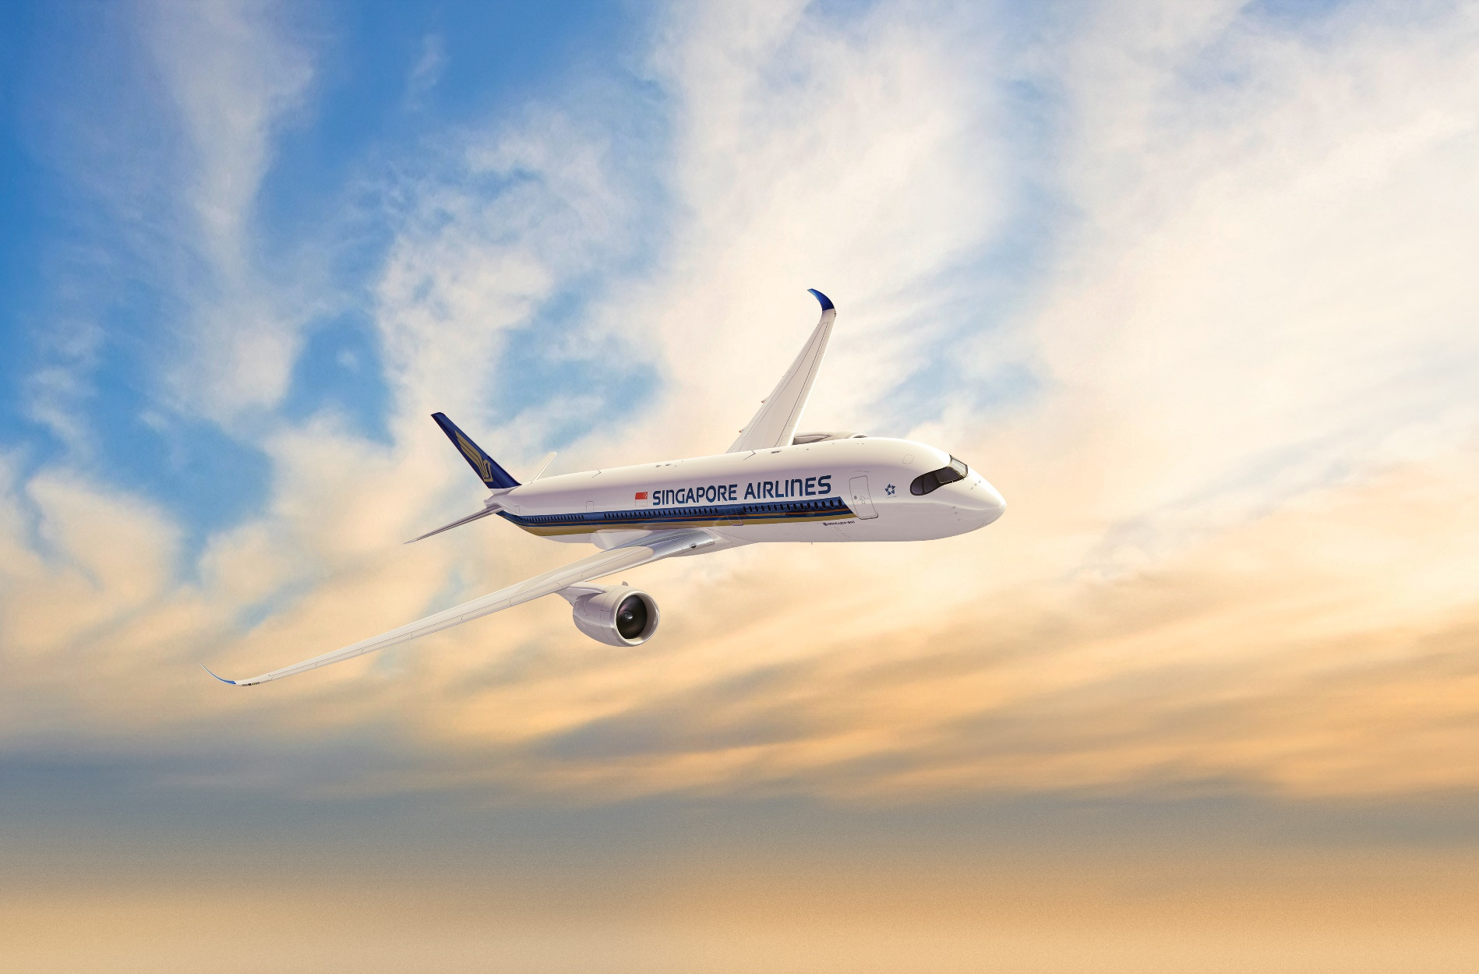
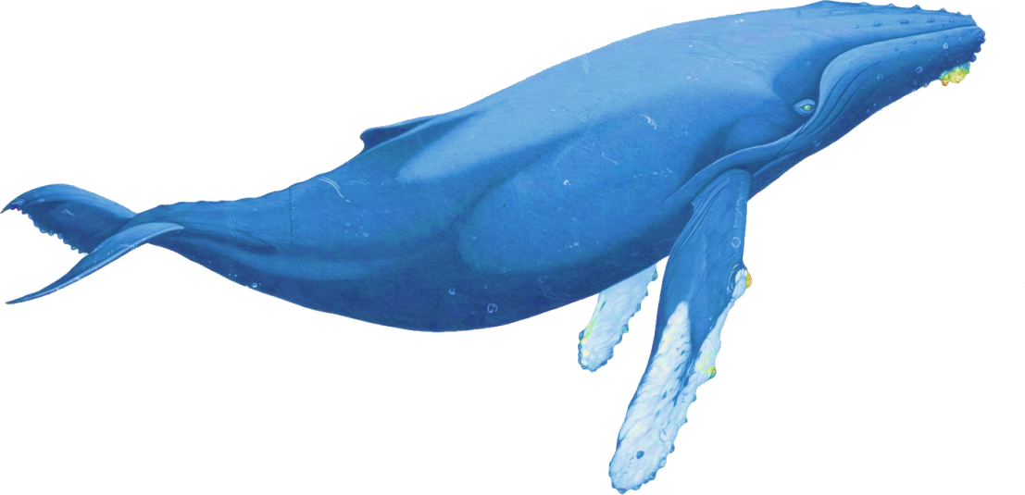

LOCATION
BASED
GROUND
TOUR
APP CHALLENGE 2019
MAKE AIR INTERESTING AGAIN

Slide 2
Some elements you could have
Title
Intro
Problem
Research
The name of your proposal. Make it meaningful!
Introduce your team
What is the opportunity or problem you want to solve?
Tell us about your research, hypothesis, insights, surveys, market study etc.
Your
Idea
Technology
Feel free to deviate or mix & match from the format if needed. You may need more, less or entirely different slides depending on your idea.
Present your idea, and the overall value proposition
Explain how it works, the architecture and mechanisms
Business
Value
Project
Plan
Demo
References
Show us some screenshots or videos of your idea if it’s working
What is the projected revenue or savings?
What is needed for your idea to work? Tell us your roadmap?
Links to your documentations and resources if any

Slide 3

Location Based Ground Tour
Make Air Interesting Again
Make Air Interesting Again
Watching from Sky
Interacting from Sky
Experiencing from Sky

Slide 4





Team Introduction
Roaring
Whale
Startup Company
in Shenzhen, China
We are
Programmers, Trekkers, Explorers
We are
Experts in the fields of
AR IOTA SLAM LBG
David
Freedom

Slide 5


The Problem / Opportunity
Today people flying always, and tired of the services provided by plane.
Most of people are just SLEEPING during the whole trip :(
NEW SERVICE MUST BE CREATED
Why is it important?
How big is the problem?
Who does it affect?
People will choose an Airlines with better experiences besides price.
Commercial services could be accepted by people during the trip.
I have no accuracy statistic data about the percentage of passengers who are sleeping, but we all have seen the facts.
I am sleeping always, boring.
Plane is flying, Ground is changing. These dynamic information are interesting and never be boring if service based on them.
Every passengers will be involved in the service.

Slide 6

4. Research Findings
Show us what research you have done to back your idea
Leverage on user journey mapping to show us where and what you want to address
Do you have any hypothesis? And how will you validate it?
Are there any data and statistics to support your idea? (You may use secondary data and publicly available data and research to back you)
What are the existing solutions out there? How does your idea stand out from the rest?
Customer Journeys
Market
Scan
Surveys & Statistics

Slide 7


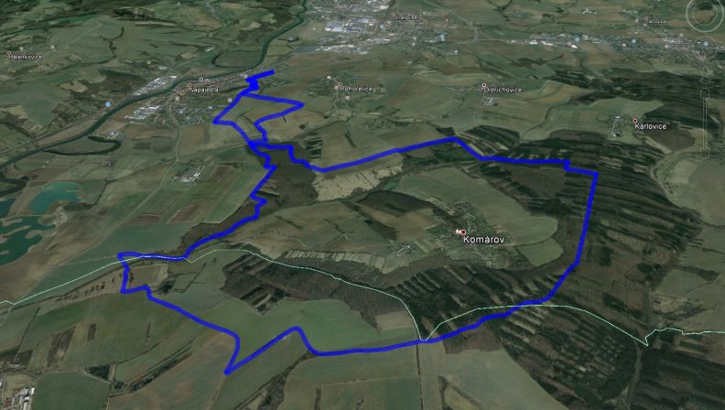
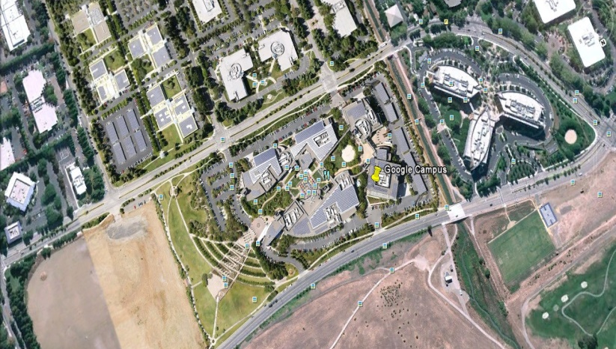
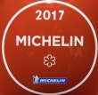
Our Idea
The Scenario
Passengers can see and manipulate Ground View.
Ground View changes according to the location of plane.
Dynamic Information are layered onto the Ground view.
Passengers can interact with interesting information, or gaming.
Nan Chi
French Style
40 Seats
$30 per person
Xiao Lu
Book Now
16 Km long, Grass covered
Diff.
4 Teams is calling members
Join Other Team
Arrange Private Tour

Slide 8
Our Idea
Present your concept
Leverage on your research and data from before to lead into this
State clearly your value proposition
Explain exactly how it solves the problem, or how this brings value to your stakeholders
Be creative in how you want to present your idea (e.g. visuals, infographics, videos)

Slide 9






Our Technology
Map
Information
Local
Services
Engine

Slide 10
6. Your Technology
Explain in depth how your idea works and the architecture
Consider elaborating on the points below:
What is the underlying mechanism?
What is the technology stack that you are using?
What is your secret sauce behind your technology?
How is your solution implemented?
Is your solution technically and operationally feasible?
Do you have any architecture diagrams or flow chats to explain your solution?
Have you considered info security and data privacy concerns?

Slide 11
Demo
“
If a picture is worth a 1000 words, a prototype is worth a million slides
Yet we have not implemented the Demo
BUT
We have made lots of Projects which based on the same technology
We knew the key point of solution, including Game, Location, Map development

Slide 12

7. Demo
(Optional)
Showcase what you’ve got if you already have a working solution
Be sure to highlight the key features and functionality
If you have already gotten feedback or reviews from testers, do share with us
“
If a picture is worth a 1000 words, a prototype is worth a million slides

Slide 13
Business Value
What is your projected earnings, savings, and cost for your solution?
What other values can your solution bring to the table?
Direct Financial
Strategic
Operational
- Increased Revenue/ Increased number of users
- Cost Savings
- Reduced Asset Utilisation
- Applicability to other new ventures
- First Mover Advantages
- Pre-emptive strike against potential future threats
- Operational efficiencies achieved
- Potential for method to be propagated to other processes
- Eases bottlenecks/ reduces dependencies on other parties
Branding
Technological
Consumer/ Employee Satisfaction
- Increased happiness scores
- Reduced frictions/ waiting times
- Minimizes chances of adverse events
- Increased opportunities for publicity and marketing
- Novelty of solution strengthens existing branding or forges new images
- Development of key underlying technologies internally
- Adoption of better technology frameworks and practices

Slide 14
8. Business Value
What is your projected earnings, savings, and cost for your solution?
What other values can your solution bring to the table?
Direct Financial
Strategic
Operational
- Increased Revenue/ Increased number of users
- Cost Savings
- Reduced Asset Utilisation
- Applicability to other new ventures
- First Mover Advantages
- Pre-emptive strike against potential future threats
- Operational efficiencies achieved
- Potential for method to be propagated to other processes
- Eases bottlenecks/ reduces dependencies on other parties
Branding
Technological
Consumer/ Employee Satisfaction
- Increased happiness scores
- Reduced frictions/ waiting times
- Minimizes chances of adverse events
- Increased opportunities for publicity and marketing
- Novelty of solution strengthens existing branding or forges new images
- Development of key underlying technologies internally
- Adoption of better technology frameworks and practices

Slide 15
Project Plan & Next Steps
Share with us your roadmap
Timeline & Milestones:
List of future deliverables and targets for your prototype
Future Resources:
What resources would you need to implement your idea? Access to data and APIs?
Implementation Plan:
What is your proposed path to launch, what would be the implementation strategy? How will you test and trial your solution?

Slide 16
9. Project Plan & Next Steps
Share with us your roadmap
Timeline & Milestones:
List of future deliverables and targets for your prototype
Future Resources:
What resources would you need to implement your idea? Access to data and APIs?
Implementation Plan:
What is your proposed path to launch, what would be the implementation strategy? How will you test and trial your solution?

Slide 17

10. References
Do you have more to share?
Share with us your Github project regarding your idea if you already have one
Any additional relevant documentation about your solution will be helpful
References to your past use cases would definitely boost your credibility
Give us your reference links <here>

Slide 18

THANK YOU
David
Dooyo CEO
www.dooyogame.com

